Slide 1
Session 7
Language, code, society

Slide 2

Basil Bernstein (1924-2000)
Bernstein’s theory shows how the language (British) people use both reflects and shapes the assumptions of a certain social group
working-class vs. middle-class
The educational context
relativistic model
Restricted code / elaborated code

Slide 3
Elaborated and restricted codes
Restricted code:
spoken in the family, amongst friends, in tightly knit communities
characterised by economical use of language; doesn’t spell everything out; conveys a vast amount of meaning with few words;
used in circumstances that allow speakers to ‘condense’; requires background information and prior knowledge
unplanned discourse, context-dependent, relies on the language material and structures acquired during one’s early socialization phases
this code sets the roles of the interlocutors
Elaborated code:
works well where more thorough explanation is required;
can ‘stand on its own’: complete and full of details
understandable for those overhearing a conversation
It has to be elaborate because the circumstances don’t allow the speakers to condense
planned discourse, rather context-free, draws on language material and structures acquired via literacy
roles of interlocutors are more open

Slide 4
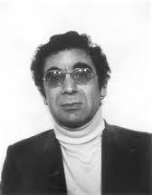

Basil Bernstein vs. William Labov
Why do working-class pupils perform poorly, compared to middle-class pupils, in language-based subjects (while doing well in mathematics-related subjects)? I believe that “forms of spoken language in the process of their learning initiate, generalize and reinforce special types of relationship with the environment and thus create for the individual particular forms of significance” (1971: 76). The restricted and the elaborated codes are not only different ways of saying, but, crucially, also different ways of meaning! Working-class children do not grow up in an environment conducive to the acquisition of the elaborated code - which is the only code in which educational knowledge can be expressed…
I disagree. Language and social class are certainly related, but the correlation concerns form – not meaning! We are dealing here with ‘alternative ways of saying the same thing’! In BEV you say ‘the buses be coming late’, in SE you say ‘the buses are usually late’; it means the same, but there are two different grammars (codes) in use. For sure, the two structures are different sociolinguistically speaking but not on the semantic level. Which code you use has nothing to do with your cognitive abilities.
What Bernstein treats as ‘code differences’ are actually merely stylistic preferences between speakers: class-related selections from the range of possible English sentences
The studies on ‘Black English Vernacular’ by American sociolinguists are limited to surface concepts such as ‘context’ and ‘linguistic variety’. It neglects to analyse the deeper, underlying problems of how educational knowledge is transmitted.

Slide 5
What educational psychologists studied in the black communities of the US was not actually the ‘restricted code’ as I intended it, namely as a ‘condensed’ and ‘highly packed’ form of speech. They simply appropriated my term and applied it to situations in which African-American (pre)school children’s linguistic performances as part of test interviews were poor (e.g. they didn’t answer back in full sentences). Hence, for these psychologists, the question ‘Where is the squirrel?’, when asked in the schoolroom, requires the standard answer ‘The squirrel is in the tree’ – and not the vernacular (and illogical) answer ’In the tree’. But answering ‘in the tree’ (instead of the full form) is not a representative example of ‘restricted code’, nor is the answer ‘The squirrel is in the tree’ an example of elaborated code. The restricted code is not the same as ‘speaking in monosyllables’ and being ‘reluctant to converse with others’! Not at all: in fact, the middle-class speakers in the UK equally make use of this code – the difference is that their environment encourages them to make use of the elaborated code in educational contexts…Switching between the two codes, in fact, is what makes a middle-class identity.

Slide 6
‘The Logic of Nonstandard English’ (Labov 1969)
“The social situation is the most powerful determinant of verbal behaviour […] an adult must enter into the right social relation with a child if he wants to find out what a child can do: this is just what many teachers cannot do.” (Labov, 1969, p. 191)
“We see [the ghetto] child bathed in verbal stimulation from morning to night” (ibid.)
“Is it true that all of the middle-class verbal habits are functional and desirable in the school situation? Before we impose middle-class verbal style upon children from other cultural groups, we should find out how much of this is useful for the main work of analyzing and generalizing, and how much is merely stylistic – or even dysfunctional. […] Is the ‘elaborated code’ of Bernstein really so ‘flexible, detailed and subtle’ as some psychologists believe? […] Isn’t it also turgid [pompous], redundant, and empty? Is it not simply an elaborated style, rather than a superior code or system? (p. 102)

Slide 7
The Logic of Nonstandard English (Labov 1969)
In many ways working-class speakers are more effective narrators, reasoners and debaters than many middle-class speakers who temporize [delaying an answer, the purpose of a statement], qualify, and lose their argument in a mass of irrelevant detail. […] The average middle-class speaker […] is enmeshed in verbiage, the victim of sociolinguistic factors beyond his control. (p. 193)
Larry vs Charles:
The AAVE speaker’s rhetorical style: Larry can sum up a complex argument in a few words, the full force of his opinions comes through without qualification or reservation […] Larry is a skilled speaker with a great ‘verbal presence of mind’, who can use the English language expertly for many purposes. (p. 194/196)
Without the extra verbiage and [….] words like science, culture and intoxicate, Charles M. appears as something less than a first-rate thinker. The initial impression of him as a good speaker is simply our long-conditioned reaction to middle-class verbosity: we know that people who use these stylistic devices are educated people, and we are inclined to credit them with saying something intelligent. […] Charles succeeds in letting us know that he is educated, but in the end we do not know what he is trying to say, and neither does he. (p. 199-200)

Slide 8
The best we can do to understand the verbal capacities of children is to study them within the cultural context in which they were developed. … To ask a child from the ghetto an impersonal question in a formal and (what must appear as a) threatening situation, serves to validate the ‘verbal deprivation theory’. This kind of research does nothing to understand the true nature of other dialects of English, and, even worse, it nurtures the teachers’ bias that nonstandard speech can have no ‘elaborated codes’.
All too often, ‘standard English’ is represented by a style that is simultaneously overparticular and vague. The accumulating flow of words buries rather than strikes the target. It is this verbosity which is most easily taught and most easily learned, so that words take the place of thought, and nothing can be found behind them.
When Bernstein described his ‘elaborated code’ in general terms, it emerges as a subtle and sophisticated mode of planning utterances, achieving structural variety, taking the other person’s knowledge into account, and so on. … However, teaching lower-class children middle-class speech habits does not mean that one is teaching them to ‘think logically’.

Slide 9
Working-class people tend to cluster in tightly-knit communities and groups, their social roles are less open – their lives are spent mostly within inner circles, amongst family, friends: hence it suffices for them to learn a restricted code. They don’t learn to elaborate a great deal, which is what the educational system requires us to do in order to succeed: explain, elaborate, expand. These are ‘skills’ you have to learn – whether you like it or not.
I don’t think working-class people should swallow middle-class ideology lock, stock and barrel via education. If you can express something succinctly, by avoiding redundancies: why not take this as a model? I don’t think middle-class speech behaviour should be imposed within the educational setting. We don’t need more pompous twits…! In fact, in the 1990s I supported the idea of African-Americans being taught at school in their own dialects. These ‘dialects’ are not at all deficient or illogical…!
“The idea is widespread in the USA that Labov has discredited Bernstein, and the strong implication is made that if you don’t agree with that you’re a racist”. (Stubbs 1983: 79)

Slide 10
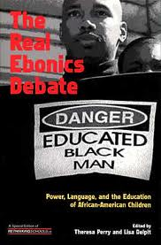

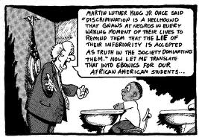
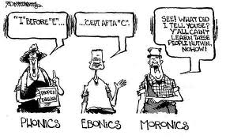
The 1996 Ebonics controversy:
Is AAVE an independent ‘language’, or a ‘dialect’ of English ? …

Slide 11
The Ebonics controversy
The initial OSB Task Force resolution (Dec. 1996) argued that Ebonics was a separate language from English, genetically derived from West African and Niger-Congo languages (little support in the academic world) and that African-Americans should be given ‘bilingual education’ monies. In January 1997, after a flood of critical commentaries, the OSB modified the resolution, claiming that Ebonics was a variety of English, but one with significant historical influences from African languages (‘creole’ origins of AAVE, academic support). The original claim was not altered, namely that Ebonics should be recognized as a legitimate medium and that resources should be allocated for preparing teachers and materials to that end. In May 1997, the OSB Task Force submitted a final report, in which the term ‘Ebonics’ no longer figured. It only stated that special efforts and resources should be devoted in order to improve the “English language skills” of African-American students.
The OSB resolution aimed at obtaining valued symbolic status for a stigmatized variety of American English: change the definition of a ‘legitimate language’, add value to Ebonics by providing special training for teachers and credentials for those so trained and certified, provide money for special curricular materials. The effort to ‘upgrade’ Ebonics (e.g. by claiming status as a separate language) has to be seen in the light of a hierarchy of ‘school worthiness’:
Standard Language > Other (foreign) Language > Other (American) dialect
One idea behind the proposal is that by making African-Americans more linguistically confident (because their variety is officially recognised, because it has printed school materials) the inhibitions to speak and write in Standard English as part of the classroom experience would dissolve.

Slide 12
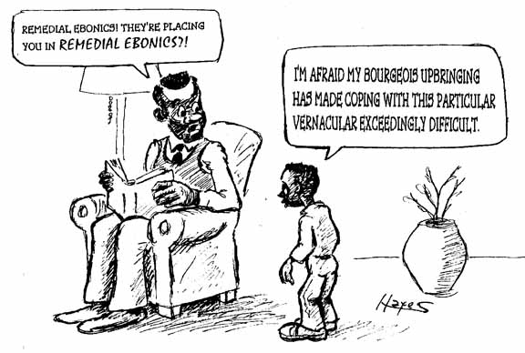
Ebonics and Gramsci ‘reversed’
Basil Bernstein and the Oakland Board of Education reached comparable conclusions concerning working-class pupils’ / African-American pupils’ achievements in language-related tests and subjects: the reason for their educational failures is ‘linguistic’. However, they recommended diametrically opposed courses of action: while the former advocated the acquisition of an elaborated code for children from working-class families, the latter opted for imparting educational knowledge via the vernacular.
Is Bernstein’s notion of ‘code’ comparable to the sociolinguistic concept of ‘dialect’ ?
Does African-American English have an elaborated code ?
In a ‘Gramscian’ fashion, some (African-Americans) saw the proposal to teach African Americans via their own dialect as a way of excluding them from education and from power.

Slide 13

Social network theory: Lesley and James Milroy
In the 1970s we did sociolinguistic fieldwork in Belfast amongst working-class Protestants and Catholics. We found that the more a speaker was integrated in a close-knit network, the less he/she will produce middle-class forms of speech; they retain their vernacular speech and are more conservative. Speakers belonging to loose-knit networks, who are thus not central members of the group, and who contract a larger number of weak links with other groups, were found to be linguistic innovators: i.e. linguistic changes spread when interpersonal contacts are weak, involving strangers or mere acquaintances.
Does the Milroys’ social network theory not lend support to my own code theory?! The closer the network, the fewer the outward links, the more ‘working-class’ the speech habits. Thus, central members of working-class communities will hardly ever need to have recourse to ‘elaborated codes’, since the ‘restricted code’ does a perfect job for their day-to-day communicational purposes…

